Slide 1
TRATTAMENTO DEL WEIGHT REGAIN CON AGONISTI DELLE INCRETINE
Esmeralda capristo
Direttore UOS di Medicina della grande Obesità
Fondazione Policlinico Universitario A. Gemelli IRCCS – ROMA
esmeralda.capristo@unicatt.it

Slide 2
Disclosures
- Eli Lilly
- Novo Nordisk

Slide 3
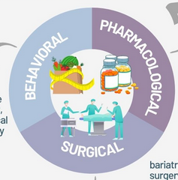
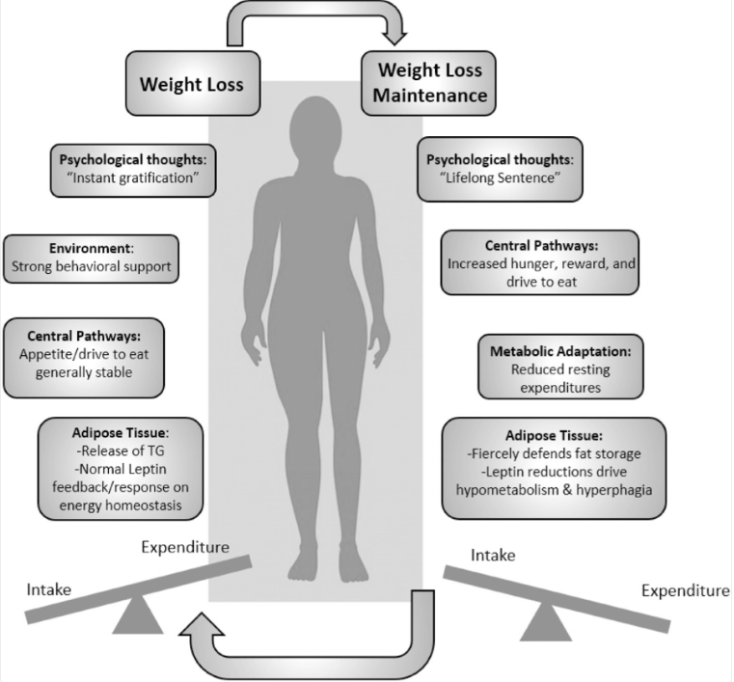
Cosa succede alla perdita di peso se interrompiamo il trattamento?

Slide 4

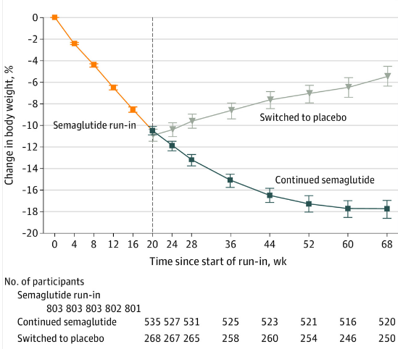
STEP 4
Rubino D, et al. JAMA 2021; 2021;325:1–12.
Notes:
The STEP 4 withdrawal trial was conducted to compare the effect of continuing once-weekly treatment with subcutaneous semaglutide, 2.4 mg, vs switching to placebo (both with lifestyle intervention) on body weight in participants with overweight/obesity who reached a semaglutide treatment dosage of 2.4 mg once weekly during an initial 20-week run-in.
This trial was a 68-week, randomized, double-blind, placebo-controlled withdrawal study conducted at 73 sites in 10 countries
In this randomized clinical trial of adults with overweight or obesity, 803 participants completed a 20-week run-in of weekly treatment with subcutaneous semaglutide, 2.4 mg, with a mean weight loss of 10.6%, and were randomized to continued treatment with subcutaneous semaglutide vs placebo for an additional 48 weeks. At the end of this time, mean weight change was −7.9% vs +6.9%, respectively, a difference that was statistically significant.

Slide 5
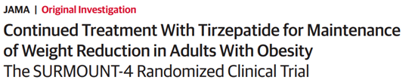
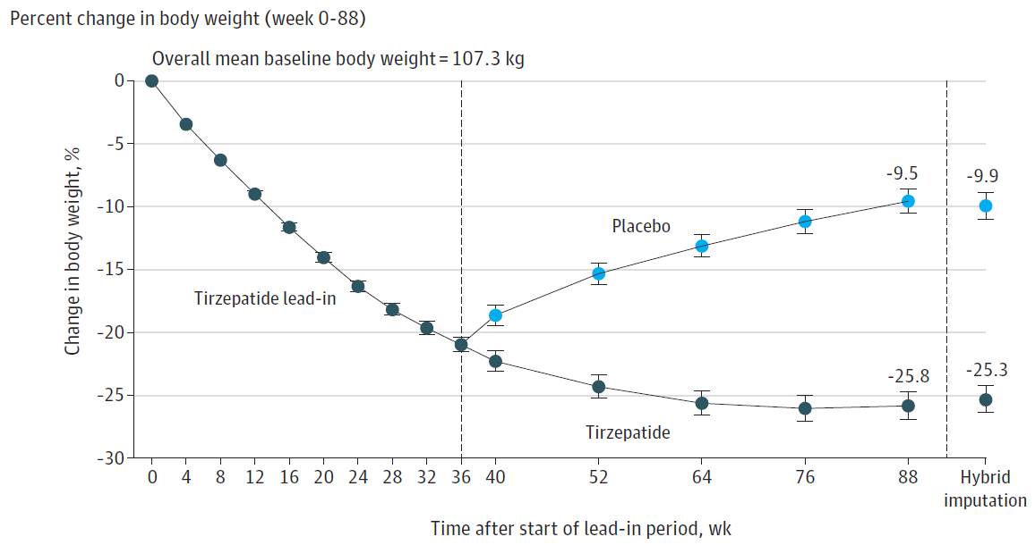
SURMOUNT 4
-16.3
-20.9
Aronne LJ, et al. JAMA. 2024;331(1):38-48

Slide 6
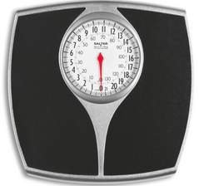
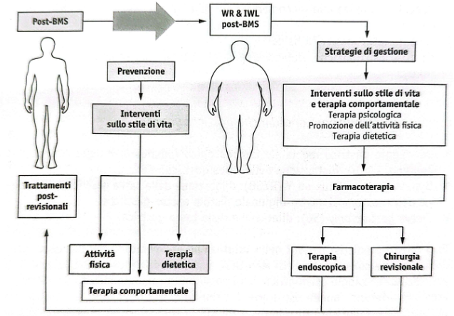
Prevenzione del weight regain dopo MBS
Va considerato dopo circa 24 mesi dal primo intervento, periodo dopo il quale gli effetti della procedura metabolica e bariatrica si sono stabilizzati;
Va riferito ad un incremento ponderale progressivo superiore al 20-25% del peso totale perso;
Va riferito ad un incremento ponderale sufficiente a reinserire il paziente nella classe di Obesità che lo aveva reso candidabile all’intervento;
Va riferito ad un incremento ponderale associato ad inadeguato controllo delle complicanze.
WR: weight regain; IWL: insufficient weight loss; MBS: chirurgia bariatrica metabolica.
EAES Guidelines. Surg End 2020; Manuale SICOB, ADI, SIO 2025.

Slide 7
Definizioni più utilizzate in ordine di frequenza nei diversi studi condotti:
un aumento >10 kg rispetto al peso minimo raggiunto dopo chirurgia bariatrica (peso al nadir);
un aumento >25% del peso in eccesso perso dal nadir;
un aumento di 5 kg/m² di BMI dal nadir;
un qualsiasi aumento di peso dalla remissione del diabete mellito di tipo 2;
il ritorno a un BMI > 35 kg/m² in seguito a soddisfacente perdita di peso attraverso la chirurgia bariatrica;
qualsiasi recupero di peso in seguito alla chirurgia bariatrica.
Grande disomogeneità di prevalenza negli studi sul recupero ponderale post-bariatrico
Busetto L, et al. Endocrinologo 2022;23:469–75.

Slide 8

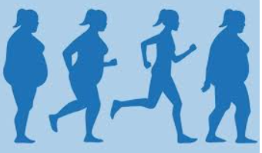

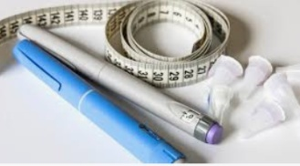
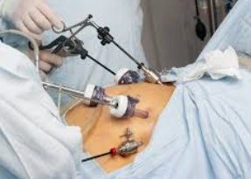
Significant Weight Regain (WR): any weight regained by the nadir than lends itself to the value or is very close to the initial value (first evaluation) with a detrimental effect on the quality of life or involving clinically inadequate control of metabolic complications.
Insufficient Weight Loss (IWL): weight loss < 20% of the initial weight or that does not shift the patient to a class of obesity different from the initial one or that does not lead to control clinically significant metabolic complications.
Lifestyle
Intervention
Obesity-Management
Medication
Redo
Surgery

Slide 9
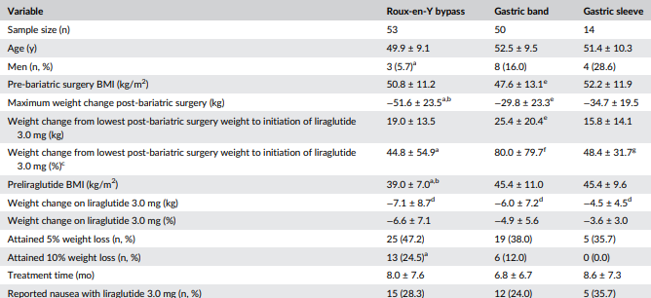
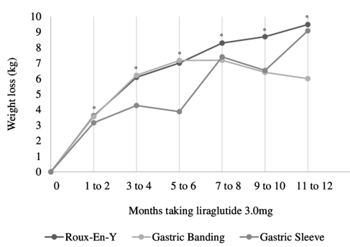
Weight loss while taking liraglutide 3.0 mg over time by type of bariatric surgery
Wharton S , et al. Clin Sci 2019; 9(4):e12323.

Slide 10
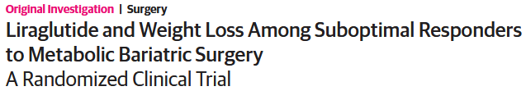
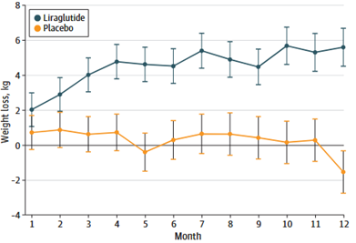
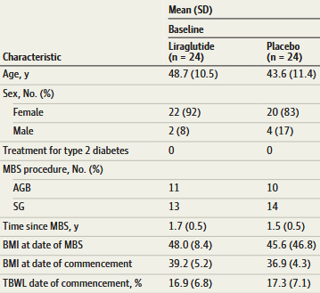
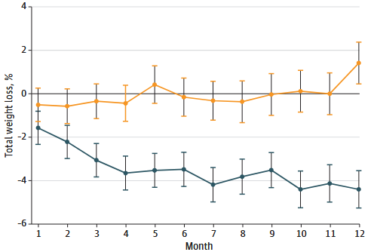

AGB: Adjustable gastric binding; SG, sleeve gastrectomy; MBS: Metabolic bariatric surgery.

Slide 11
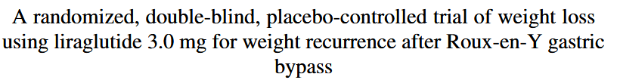
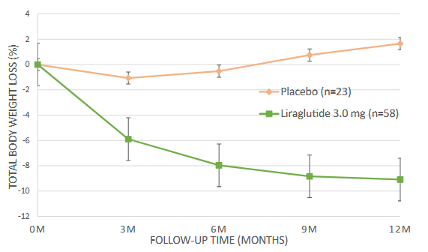
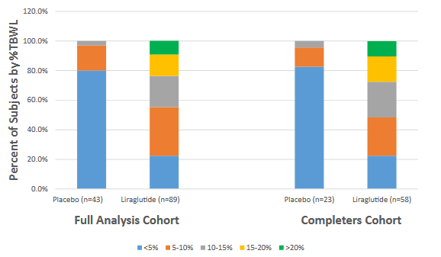
N= 132 subjects, who achieved > 25% total body weight loss (TBWL) status-post-RYGB and regained > 10% TBWL after reaching nadir weight, 18–120 months post-RYGB were randomized to receive liraglutide 3.0 mg/d (n = 89) or placebo (n = 43) with lifestyle counseling regularly for 56 weeks.

Slide 12
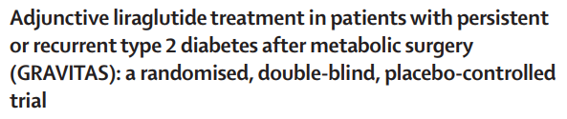
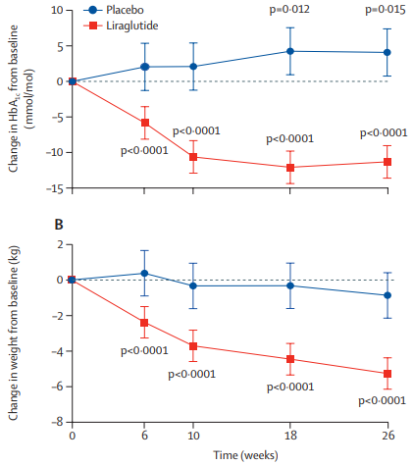
Data are means, with error bars representing 95% CIs. The p values are for change from baseline (mixed-model repeated-measures analysis, with type of surgery taken into account as covariate).
Miras AD, et al. Lancet 2019;7:549-59.
Notes:
In the GRAVITAS randomised double-blind, placebo-controlled trial, we enrolled adults who had undergone Roux-en-Y gastric bypass or vertical sleeve gastrectomy and had persistent or recurrent type 2 diabetes with HbA_{1c} levels higher than 48 mmol/mol (6·5%) at least 1 year after surgery from five hospitals in London, UK. Participants were randomly assigned (2:1) via a computer-generated sequence to either subcutaneous liraglutide 1·8 mg once daily or placebo, both given together with a reduced-calorie diet, aiming for a 500 kcal per day deficit from baseline energy intake, and increased physical activity. The primary outcome was the change in HbA_{1c} from baseline to the end of the study period at 26 weeks, assessed in patients who completed the trial.
we assigned 80 patients to receive either liraglutide (n=53) or placebo (n=27). 71 (89%) participants completed the study and were included in the principal complete-cases analysis. In a multivariable linear regression analysis, with baseline HbA_{1c} levels and surgery type as covariates, liraglutide treatment was associated with a difference of -13·3 mmol/mol (-1·22%, 95% CI -19·7 to -7·0; p=0·0001) in HbA_{1c} change from baseline to 26 weeks, compared with placebo. Type of surgery had no significant effect on the outcome.

Slide 13

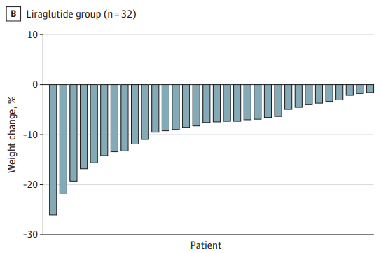
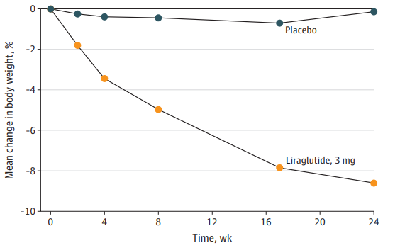
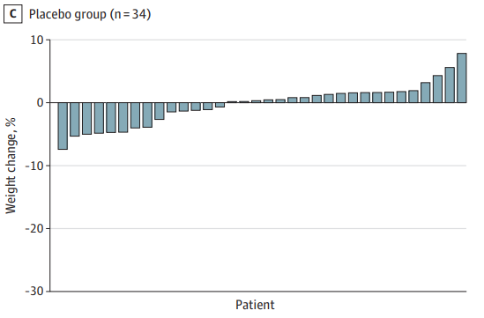
Poor weight loss ( < 20% total body weight loss from the day of surgery) is associated with lower circulating levels of glucagon-like peptide-1 (GLP-1)
Change in body weight from baseline
MOK J, et al. JAMA Surg 2023;158:1003-11.
Notes:
the aim of the Evaluation of Liraglutide 3.0mg in Patients With Poor Weight Loss and a Suboptimal Glucagon-Like Peptide-1 Response (BARI-OPTIMISE) trial was to confirm superiority of liraglutide, 3.0mg, compared to placebo on percentage body weight reduction, as an adjunct to a lifestyle intervention (500 kcal deficit), in individuals with poor weight loss after sleeve gastrectomy (SG) or Roux-en-Y gastric bypass (RYGB) with a suboptimal GLP-1 response. The BARI-OPTIMISE trial also aimed to determine whether 24 weeks of liraglutide, 3.0mg, caused greater reduction in adiposity, improvement in metabolic indices, physical function, and health-related quality of life than placebo.
Poor weight loss was defined as 20% or less total body weight loss from the day of surgery. Circulating GLP-1 levels were measured in the fasted state and 30 minutes following a 500-kcal test meal. Suboptimal GLP-1 response was defined as a 2-fold or less increase in circulating active GLP-1 between 0 and 30 minutes following the meal.
CONCLUSION: These findings support the use of adjuvant liraglutide, 3.0 mg, for weight management in patients with poor weight loss and suboptimal GLP-1 response after metabolic surgery.

Slide 14
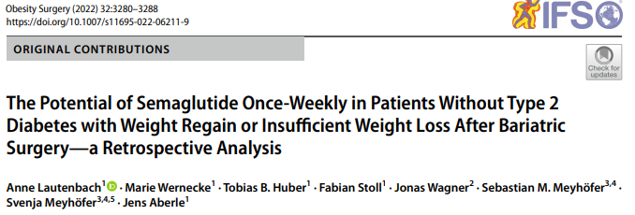
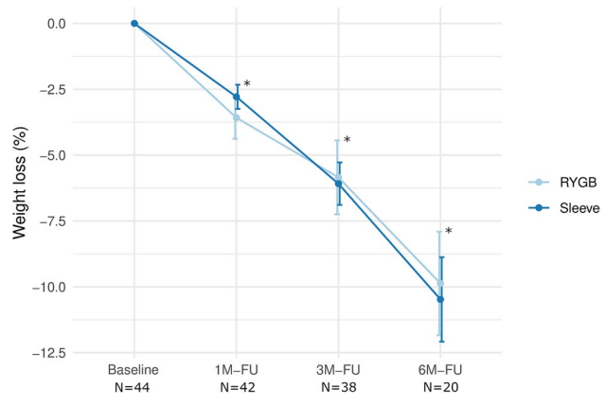
SG, sleeve gastrectomy; RYGB, Roux-en-Y gastric bypass; FU, follow-up; N, number of individuals.
Results are expressed as means and standard deviation. *Significantly different from baseline regardless of surgical group (p<0.001).

Slide 15
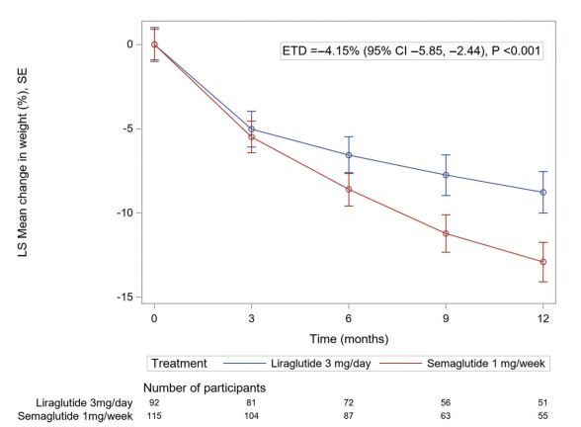
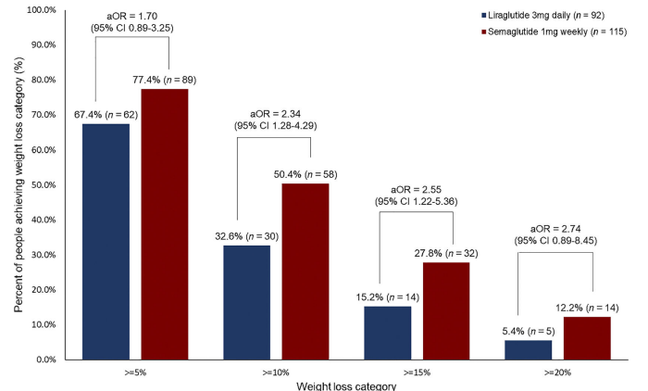
Murvelashvili N, et al. Obesity 2023;31:1280–9.
Notes:
Change in weight (percentage) after treatment with semaglutide 1 mg weekly versus liraglutide 3 mg daily in patients with weight recurrence after metabolic and bariatric surgery. ETD, estimated treatment difference; LS, least squares.
Proportion of people and odds ratios of achieving 5%, 10%, 15%, and 20% weight loss at any time over 12 months of treatment with liraglutide 3 mg daily versus semaglutide 1 mg weekly for post-bariatric weight recurrence. aOR, adjusted odds ratio

Slide 16


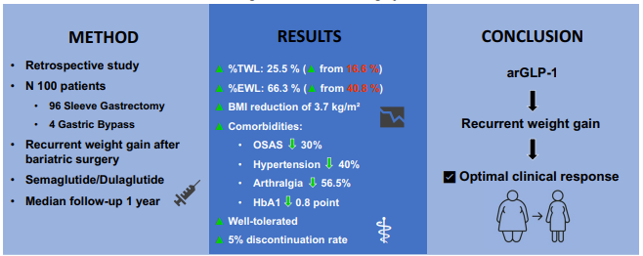
IWL: insufficient weight loss defined as < 50% excess weight loss (EWL) from baseline;
WR: weight regain defined as a ≥ 10 kg increase from the nadir weight post-surgery.
Abdallah H, et al, Obes Surg 2025 Sept.

Slide 17
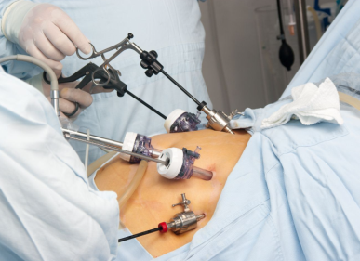
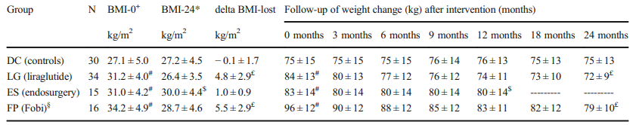

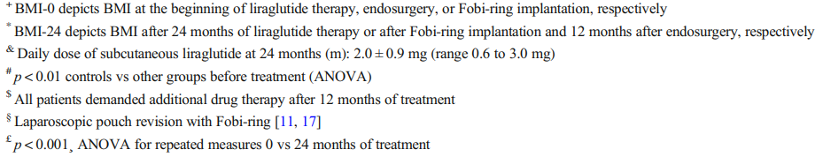
Values are given as mean ± standard deviation (SD).
Loss of regained weight from NADIR
at 24 months: - 85% with Liraglutide
Horber FF, et al. Obes Surg 2021.
Notes:
Ninety-five consecutive patients (11 male, 84 female; mean BMI 45 ± 6 kg/m2 ) undergoing RYGB 9 ± 4 years ago were treated for 24 months as follows: Patients, who gained less than 10% from weight NADIR, served as controls and were provided lifestyle counseling (DC, n = 30). The others were allowed to choose between three different treatment groups: daily s.c. administration of liraglutide (LG, n = 34); endosurgery using Apollo’s Overstitch System™ (ES, n = 15), or implantation of a Fobi-ring with pouch resizing (FP, n = 16).
Conclusions Weight regain during more than 6 years after RYGB can be safely and effectively reversed with liraglutide. Compared with revisional surgery, pharmacotherapy with liraglutide was low risk and resulted in an important improvement in hypertension and dyslipidemia. Therefore, daily subcutaneous injections of liraglutide are a valid option to treat weight regain after RYGB.

Slide 18
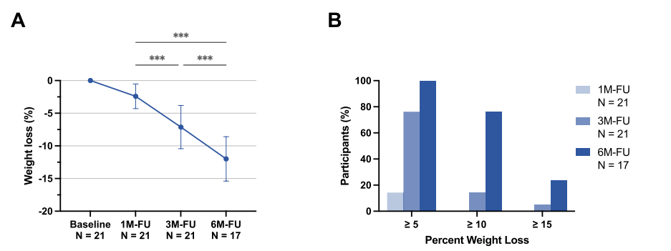
A retrospective study on the impact of adjunctive tirzepatide therapy over 6 months following sleeve gastrectomy (SG) or Roux-en-Y gastric bypass (RYGB)
FU, follow-up. N, number of individuals. Results are expressed as means and standard deviation. **, p < 0.01. ***, p < 0.001.
Notes:
Introduction: Insufficient weight loss (IWL) or weight regain (WR) after metabolic bariatric surgery remains a challenge in obesity management. Therefore, this study aimed to retrospectively evaluate the impact of adjunctive tirzepatide therapy over 6 months following sleeve gastrectomy (SG) or Roux-en-Y gastric bypass (RYGB). Methods: Post-bariatric patients without type 2 diabetes with IWL or WR (n = 21) were analyzed. Key outcomes included changes in weight, BMI, waist circumference, body composition, basal metabolism, metabolic markers, and inflammatory markers. Subgroup analyses assessed differences based on sex, surgery type, and classification as IWL or WR. Linear regression was performed to identify predictors of weight loss outcomes. Results: At 6 months, mean total weight loss was 12.0 % ± 3.4 % (p < 0.001), with significant reductions in BMI, waist circumference, body fat percentage, and HbA1c. Basal metabolism declined proportionally with weight loss. Weight loss ≥ 5 % occurred in 100.0 % of patients, ≥ 10 % in 76.5 %, and ≥ 15 % in 23.5 %. Basal metabolism differences between RYGB and SG patients converged by 6 months. Male and female patients showed comparable weight loss and metabolic adaptation. IWL patients experienced less fat-free mass loss at 3 months compared to WR (p < 0.05). Baseline BMI nadir, prior weight regain, body composition, and chronic inflammation were significant predictors of weight loss outcomes. Discussion: Tirzepatide treatment significantly enhances weight loss and metabolic health in post-bariatric patients, regardless of surgery type or sex. Differences in fat-free mass loss highlight the need for tailored interventions in IWL and WR groups. Baseline factors, including inflammation and body composition, may help predict treatment success.

Slide 19

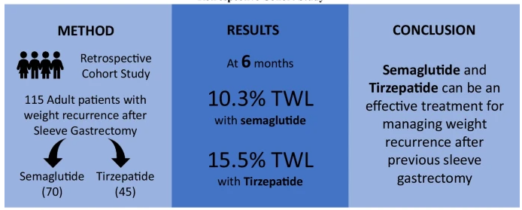
A retrospective cohort study of patients who underwent SG between January 2008 and August 2022 and sought treatment for weight recurrence with semaglutide or tirzepatide from January 2022 onwards.
Obes Surg 2024;34:1324–32.
Notes:
Short-term outcomes show that semaglutide and tirzepatide can be an effective treatment for managing weight recurrence after SG. Studies with longer follow-up are needed to determine the durability, as weight regain after discontinuation of the medication is highly likely, and the high cost of these medications can limit their use.

Slide 20

BARI-STEP: A double-blinded, randomised, placebo-controlled trial of semaglutide 2.4 mg in patients with poor weight-loss following bariatric surgery.
Bariatric surgery is the most effective treatment for patients with severe obesity producing sustained weight-loss with reduced morbidity and mortality. Roux-en-Y gastric bypass (RYGB) and sleeve gastrectomy (SG) are the commonest bariatric procedures. Whilst at a population level these operations are highly effective at reducing weight, obesity-associated morbidity and mortality; at the level of the individual, weight-loss following RYGB and SG is highly variable. Given the associated risks, procedure cost and the need for lifelong nutritional monitoring there is an urgent unmet clinical need to identify those with a poor weight loss response, improve weight-loss and maximise the health benefits for bariatric surgery patients.
BARI-STEP is a phase III b, double-blinded, randomised, parallel group trial in patients with poor weight loss following bariatric surgery. The aim of this trial is to determine whether 68 weeks of subcutaneous semaglutide 2.4 mg causes greater percentage weight loss and to estimate the extent of any reduction, reduction in adiposity, improvement in metabolic indices, physical function and health-related quality of life (HRQoL) than placebo in patients with poor weight loss following RYGB or SG.
University College London Joint Research Office
Notes:
Obesity and its associated co-morbidities represent a global health threat causing 3.4 million preventable deaths annually. The Coronavirus Infectious Disease 2019 (COVID-19) pandemic highlighted the need to maximise health outcomes for people living with obesity, who are at an increased risk of severe disease and mortality from COVID-19. Obesity leads to a pro-inflammatory state with increased production of inflammatory cytokines, which can result in impaired immune responses. In addition to improvement in co-morbidities, weight loss following bariatric surgery has been shown to improve immune function and lower rates of hospital and intensive care admission upon COVID-19 infection. Bariatric surgery is the most effective treatment for patients with severe obesity producing sustained weight-loss with reduced morbidity and mortality. Roux-en-Y gastric bypass (RYGB) and sleeve gastrectomy (SG) are the commonest bariatric procedures. Whilst at a population level these operations are highly effective at reducing weight, obesity-associated morbidity and mortality; at the level of the individual, weight-loss following RYGB and SG is highly variable. Given the associated risks, procedure cost and the need for lifelong nutritional monitoring there is an urgent unmet clinical need to identify those with a poor weight loss response, improve weight-loss and maximise the health benefits for bariatric surgery patients. BARI-STEP is a phase III b, double-blinded, randomised, parallel group trial in patients with poor weight loss following bariatric surgery. The aim of this trial is to determine whether 68 weeks of subcutaneous semaglutide 2.4 mg causes greater percentage weight loss and to estimate the extent of any reduction, reduction in adiposity, improvement in metabolic indices, physical function and health-related quality of life (HRQoL) than placebo in patients with poor weight loss following RYGB or SG.

Slide 21
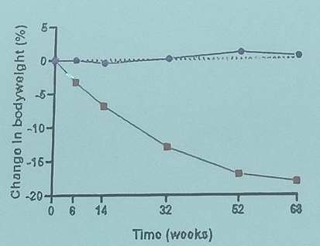
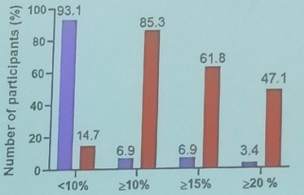
BARI-STEP: A double-blinded, randomised, placebo-controlled trial of semaglutide 2.4 mg in patients with poor weight-loss following bariatric surgery (Sleeve gastrectomy or Roux-en-Y gastric bypass.).
70 participants randomised to:
Semaglutide (N = 35) or placebo (N = 35), both groups received lifestyle intervention;
Treatment duration: 68 weeks.
Placebo
Semaglutide 2,4 mg
Body weight change (%)
Categorical weight loss (%)
Adjusted for surgery type, diabetes status, sex and initial weight.
University College London Joint Research Office
Mallik R, et al. EASD 2025
Notes:
A double-blinded, randomised, placebo-controlled trial of semaglutide 3.0 mg/ml in patients with poor weight-loss following bariatric surgery. The primary aim of this trial is to determine whether, and the extent to which, 68 weeks of subcutaneous semaglutide 3.0 mg/ml causes greater percentage weight loss (%WL), reduction in adiposity, improvement in metabolic and inflammatory indices and health-related quality of life (HRQoL) than placebo, in patients with poor weight loss following gastric bypass or sleeve gastrectomy.
Official Title
BARI-STEP:A Double-blinded, Randomised, Placebo-controlled Trial of Semaglutide 2.4 mg in Patients With Poor Weight-loss Following Bariatric Surgery.

Slide 22

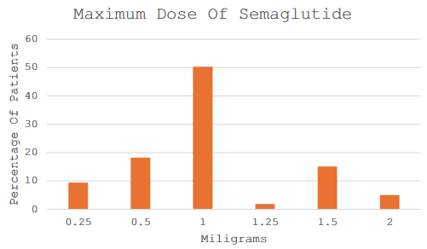
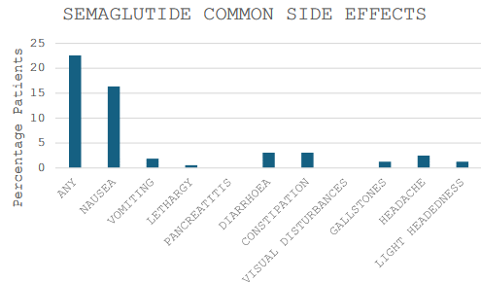

N: 159 (LAGB, LSG, GBP)
The median dose tolerated was 1 mg s/c per week, and 78% tolerated ≤ 1 mg as the maximum achieved dose. The median total weight loss (TWL) was 7.5% and side effects were uncommon. Most patients took therapy for > 6 months, but continued therapy > 1 year was uncommon.

Slide 23
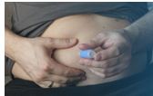


Take Home messages
Metabolic bariatric surgery (MBS) is to date the most effective treatment currently available for obesity, resulting in a durable loss of approximately 25% to 30% of total weight. MBS is generally safe, with low complication and mortality rates;
Weight regain after MBS is a well-recognized phenomenon, within 3 to 10 years following surgery. This weight regain could be associated with the recurrence of comorbidities such as type 2 diabetes, hypertension, OSAS, etc.;
The new Obesity Management Medications (OMM) seems to play a favourable role in both pre-operative weight loss and in weight regain after either surgery or endoscopic procedures.
The combination of lifestyle changes, medical, endoscopic and/or surgical approaches is able to achieve optimal care and maximise health benefits for the patient and will lead to consider obesity and its complications preventable.
One treatment or another treatment
One treatment plus another treatment

Slide 24
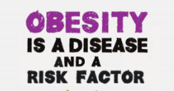
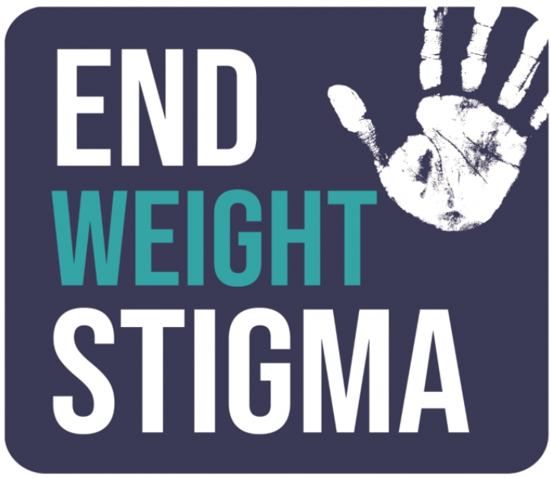
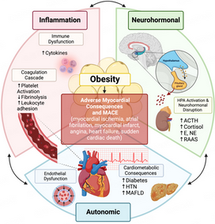

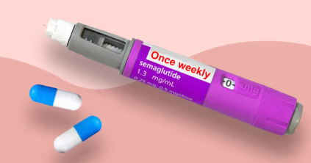
Grazie

